Slide 1
Digestive System Story

Slide 2
Let’s Begin!

Slide 4
Mouth

Slide 5
Teeth, Tongue & Saliva
Teeth : Grind up food into smaller pieces.
Saliva : Has Enzymes that help break down food and moistens it so that the food is easier to swallow.
Tongue : Helps mix the food and helps you swallow your food.

Slide 10
Esophagus

Slide 11
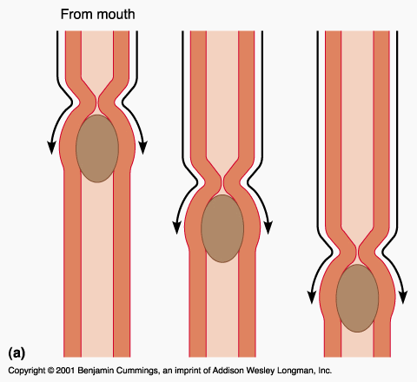
Esophagus
Takes food into the stomach through a process called
Peristalsis!

Slide 14
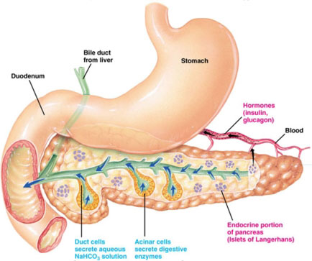
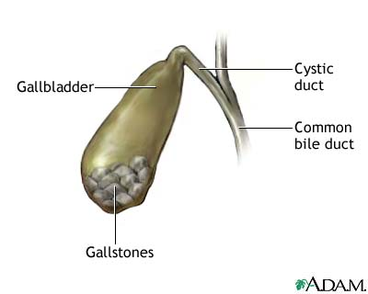
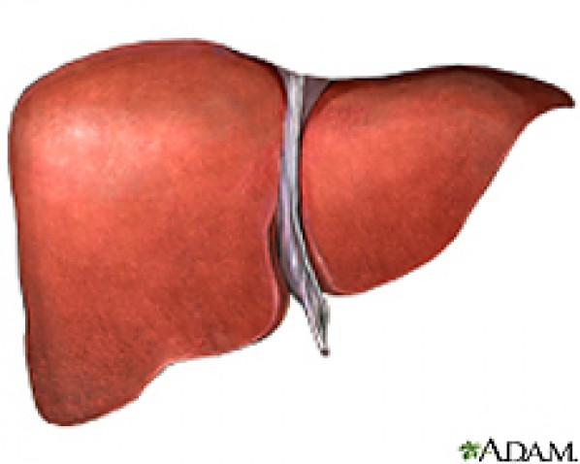
Stomach, Liver, Gallbladder & Pancreas

Slide 15
Stomach and Friends
This is where the food you eat is broken down into a more portable substance called “Chyme”
Liver : Produces a substance called “Bile” Which helps break down the food in the stomach.
Gallbladder : Stores the “Bile” which is released into the stomach when needed.
Pancreas : Produces enzymes that are released in the stomach to help it break down food.

Slide 21
Small Intestine

Slide 22
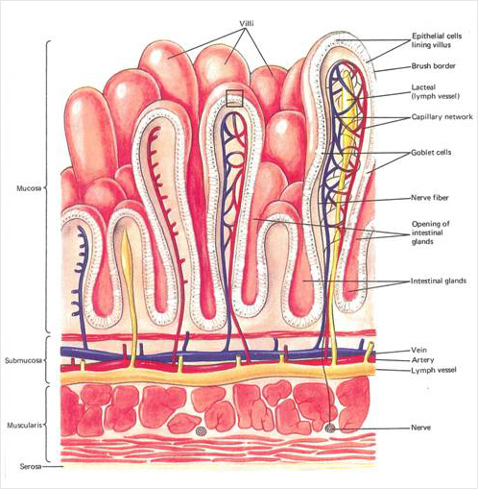
Small Intestine
This is where most of the digestion takes place in your body.
Nutrients are absorbed here by “Villi” and sent through blood vessels to supply other parts of the body.

Slide 25
Large Intestine

Slide 26
Large Intestine
To absorb the remaining water in what is left of the substance that came from your small intestine.
To transport remaining waste to the rectum to be expelled.

Slide 29
Rectum

Slide 30
Rectum
This is where the solid waste is stored until it is expelled out through the anus.

Slide 33
The End

